Slide 1







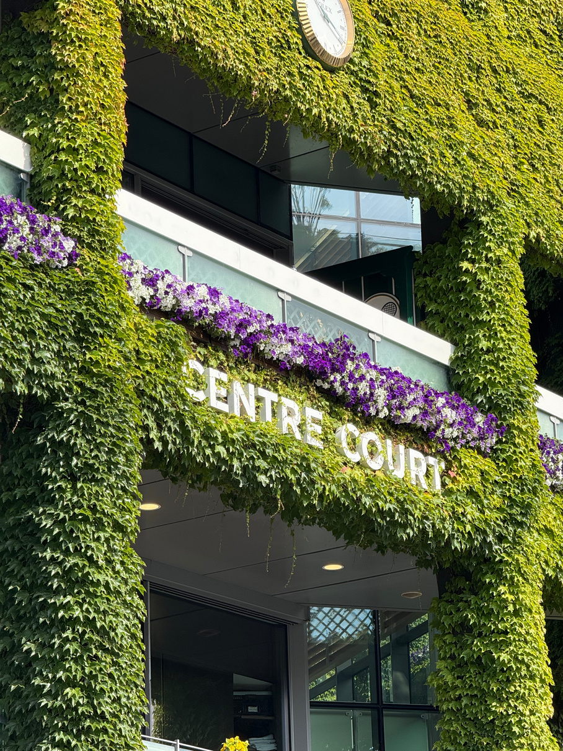
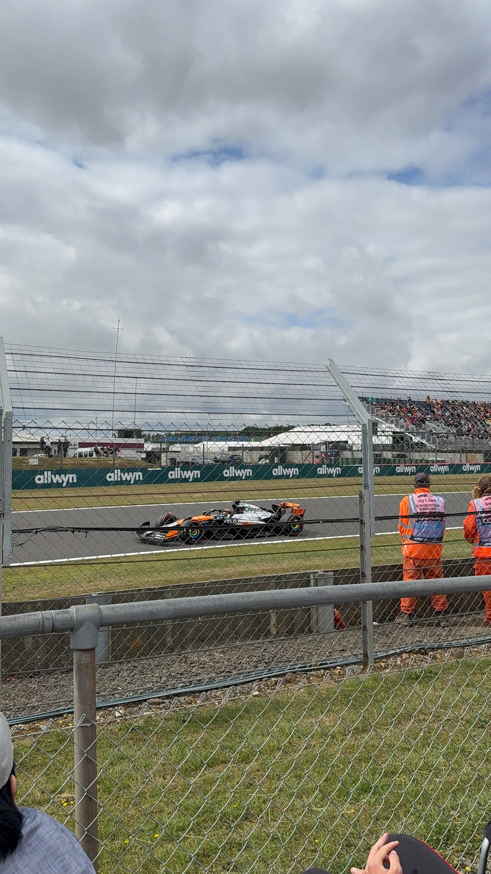
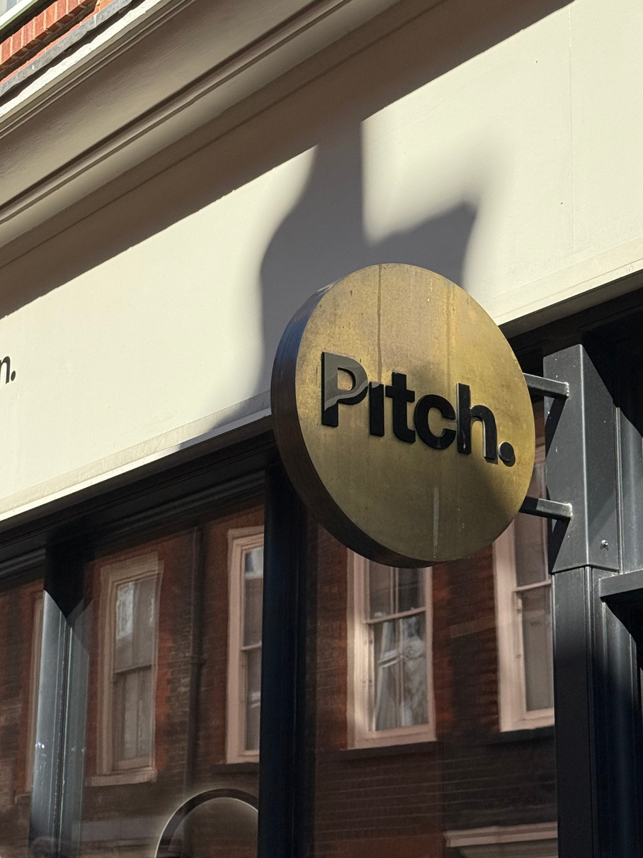







SPORTS CREATES COMMUNITY
GO TEAM!!
SPORTS ARE FOR EVERYONE (EVEN YOU)

Slide 2



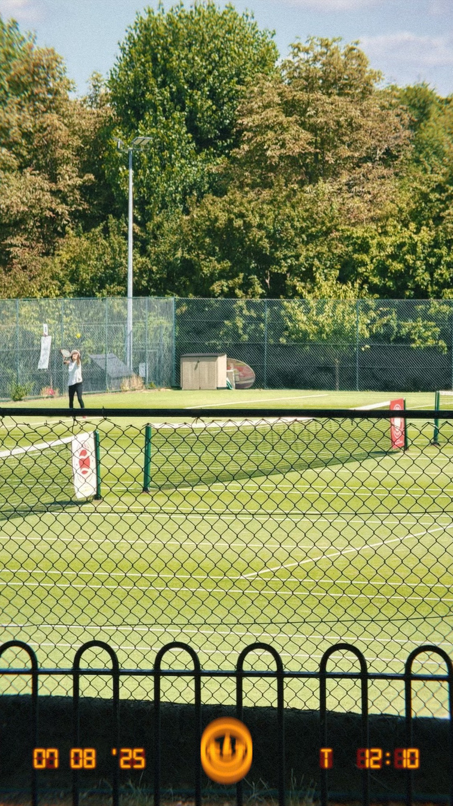
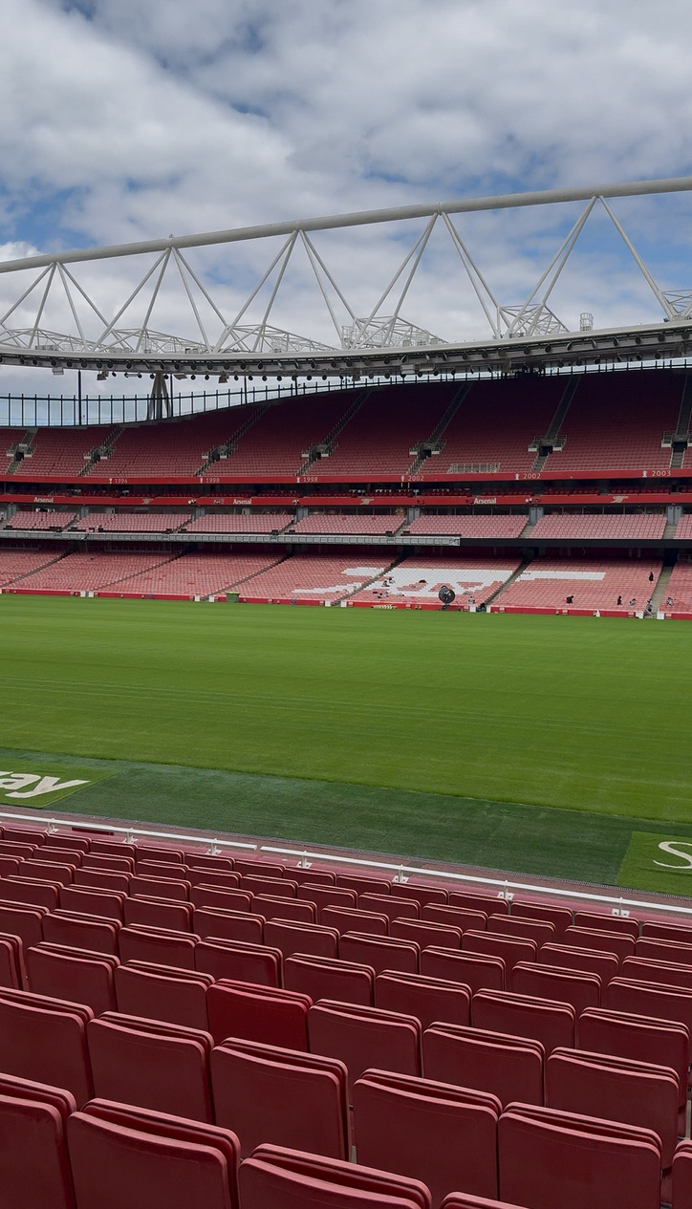

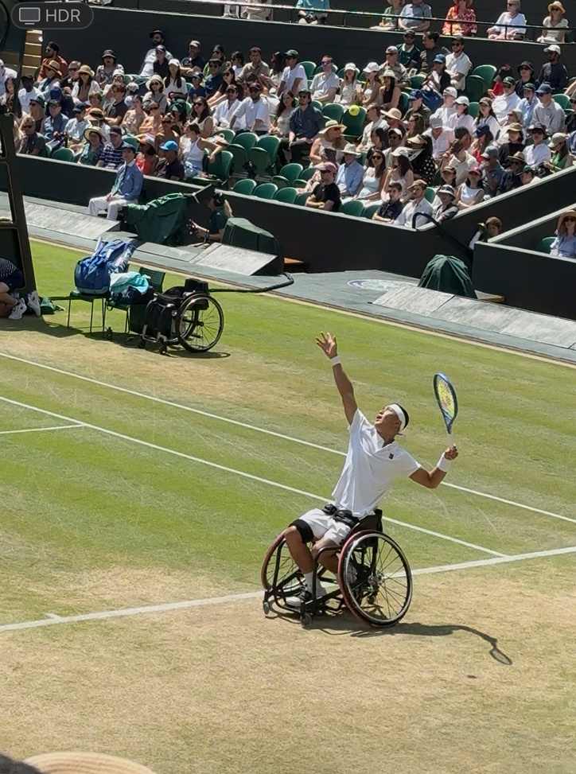
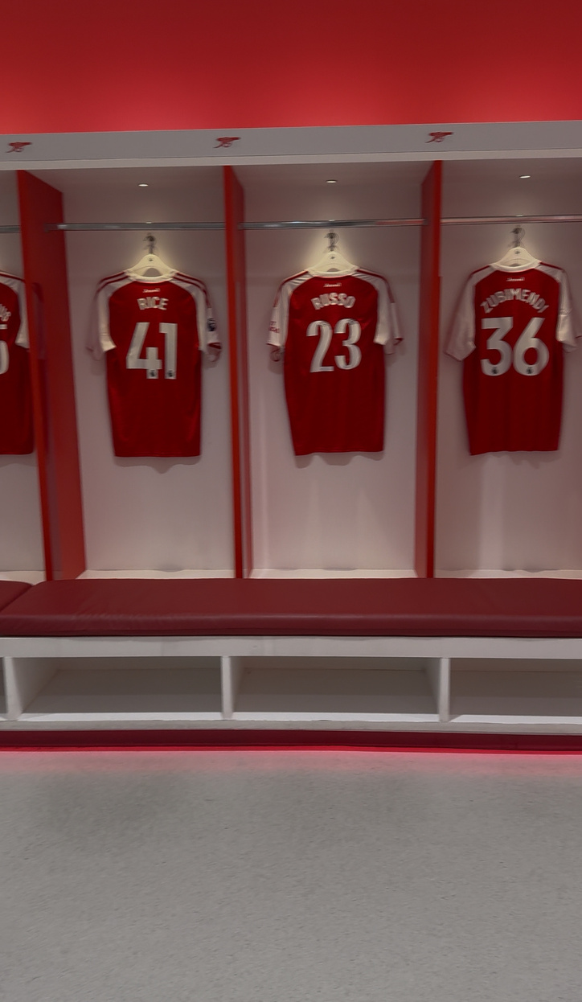

Before attending the Manship Global Sports Showcase, sports were the least of my interest. I initially joined the program to gain the opportunity to study abroad in London with other Manship students. The idea of studying in the United Kingdom was what initially drew me in, but the types of sports we were viewing also piqued my interest since they were sports I don’t usually see often (as an LSU student that’s constantly surrounded by American football and basketball). I honestly had no clue what Formula One even was or how it worked and now I’m catching myself watching the drivers’ interviews and keeping up with their race stats in my free time.

Slide 3

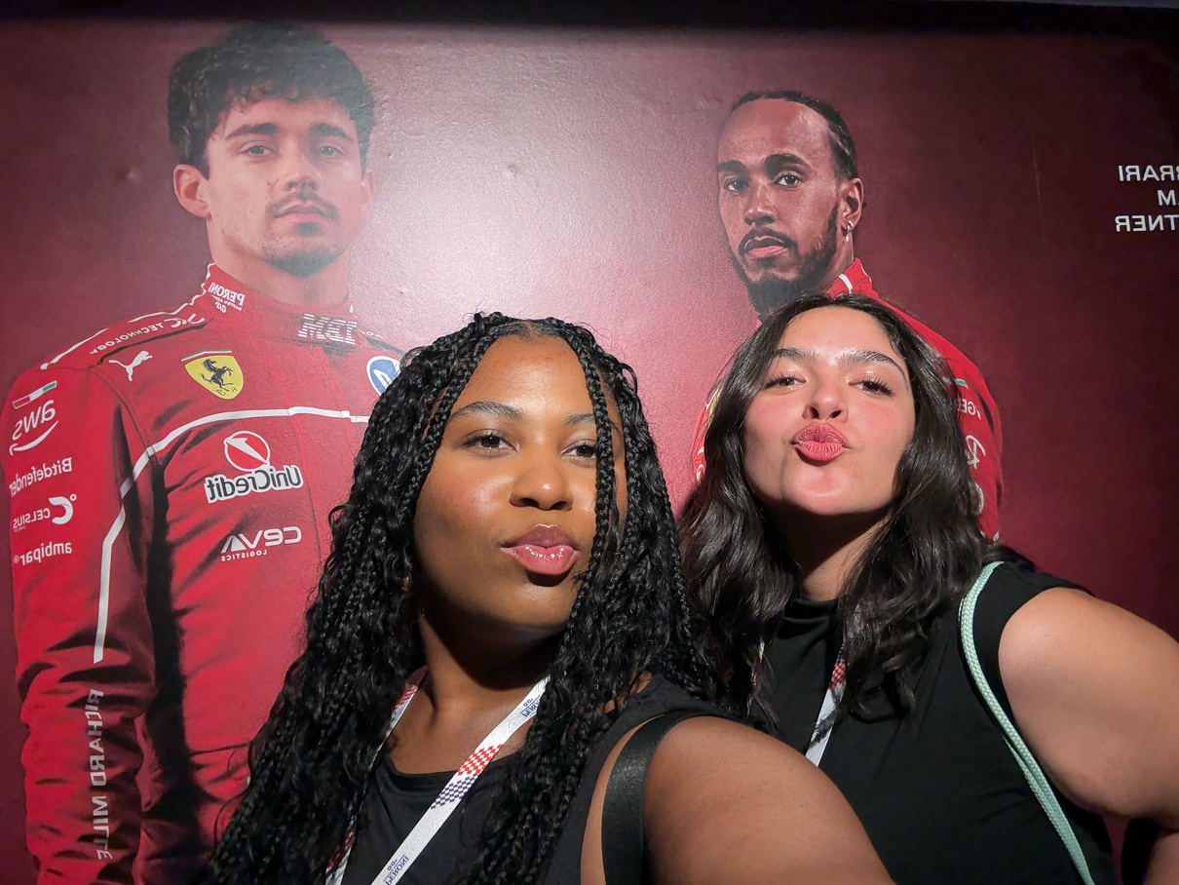


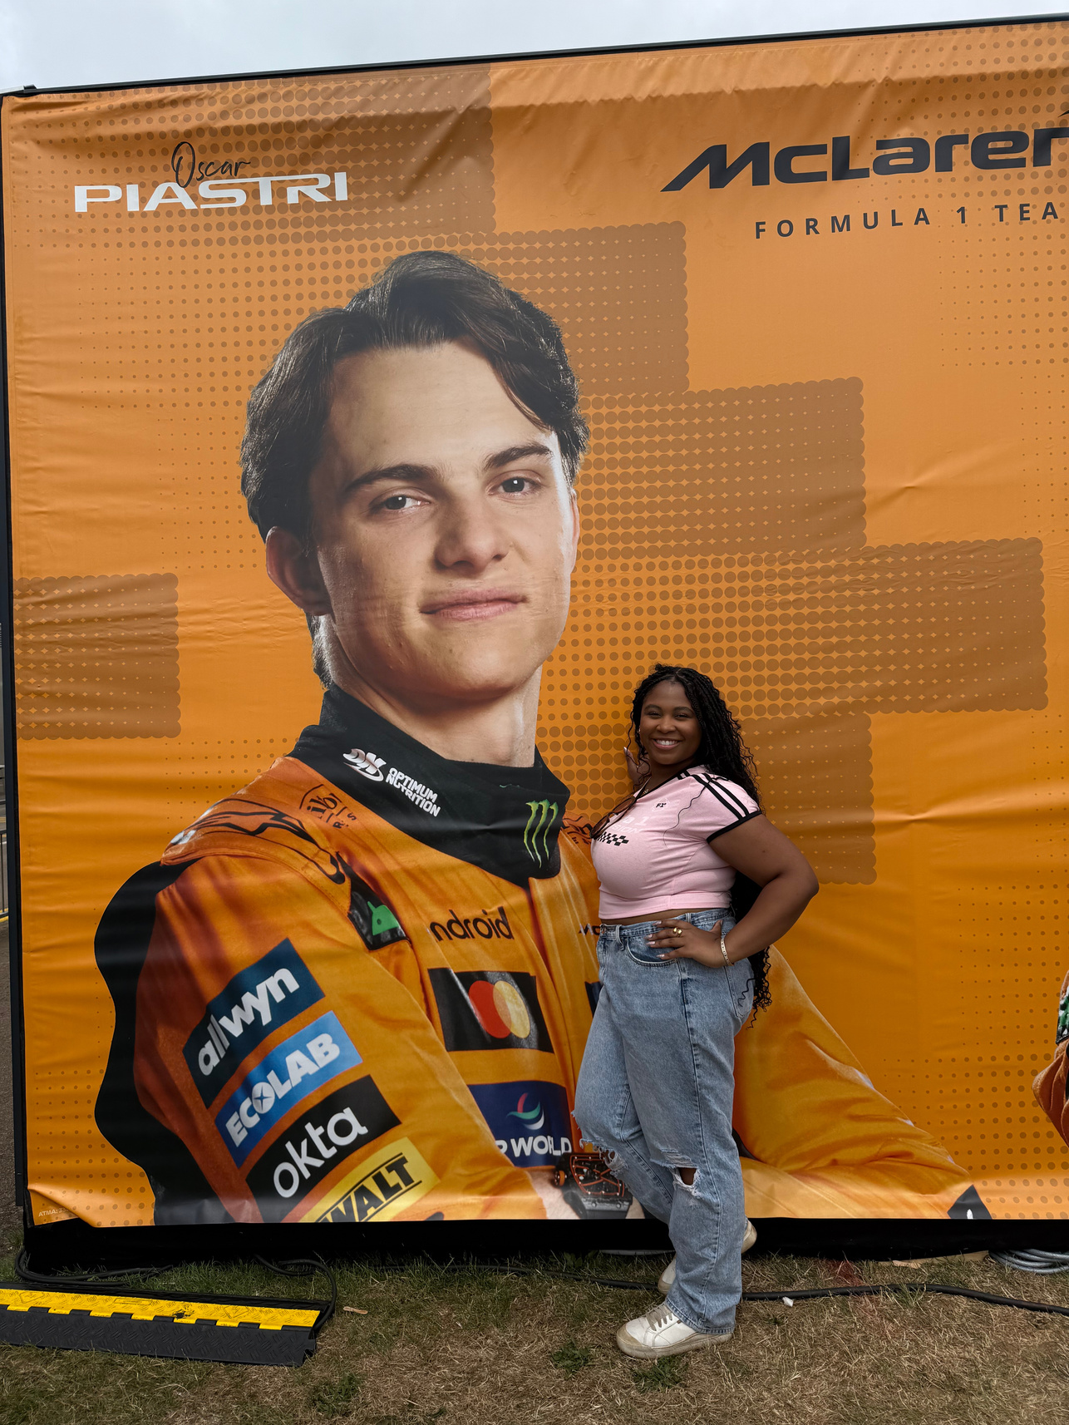
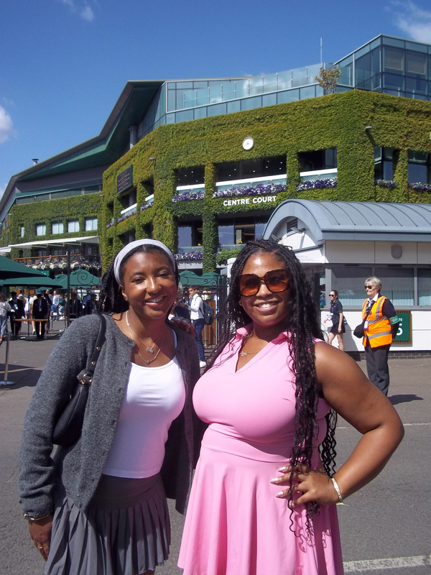
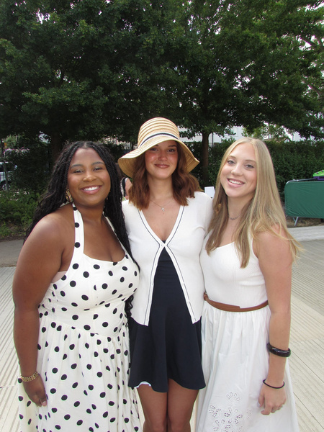

  I took to the time to make sure that I did my research before going because it is such an honor and privilege to go to these large scale events that many people dream of attending. Thanks to the Manship School, I was able to see these sporting events in person and it completely changed the way I perceive sports as a whole. By experiencing these sports firsthand, I ended up really loving and enjoying them, and it has opened my mind to new career possibilities.

Slide 4


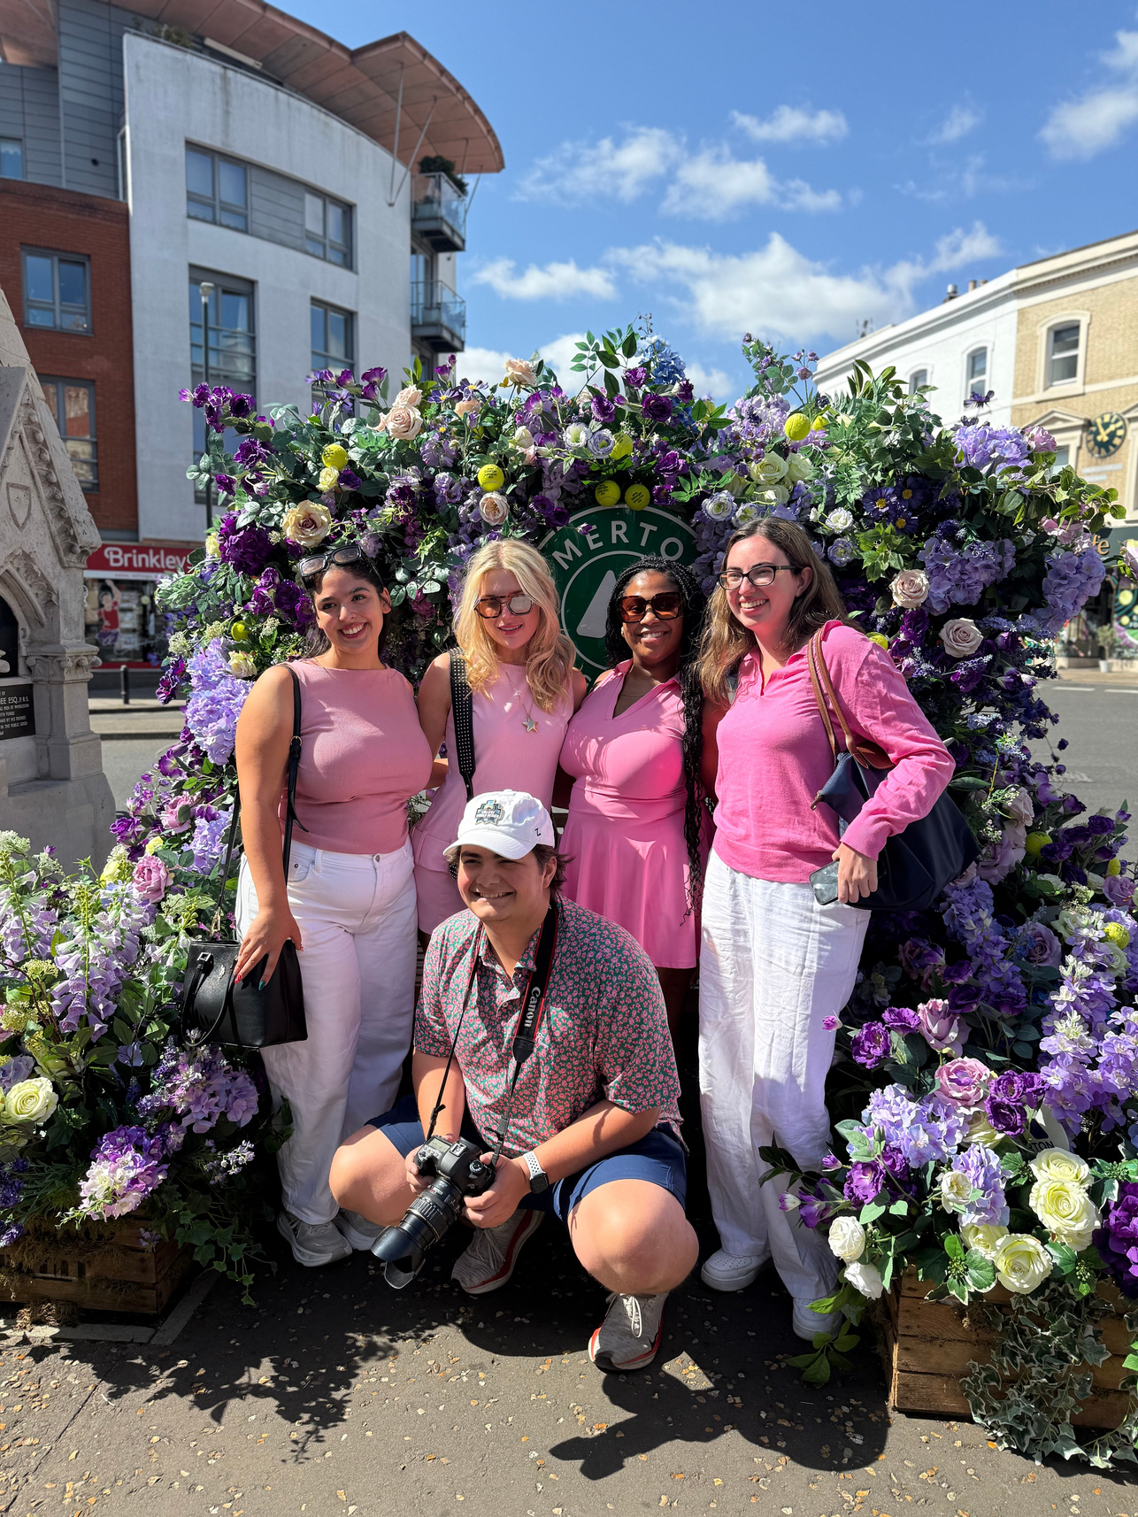

  I never considered a future in sports media simply because of my lack of knowledge of sports and the intimidation of the industry. Just like all career fields you grow and learn with trial and error. Sports don’t seem as intimidating anymore after seeing it from different global perspectives. After speaking to the female representatives working at Sky Sports and viewing the women’s rugby presentation at the Allianz Stadium, I was able to view sports as more than just a bunch of athletes competing for a trophy. These representatives made me aware of how important it is for all fans of every demographic to have a voice in what they want to see from their favorite teams. These experiences made me understand the complexities of sports media. From behind the scenes roles, to interactive broadcasting, the various angles, recaps and 3D shots seen on the big screen, this job takes a lot of collaboration and adaptability.
WIMBLEDON CHAMPIONSHIPS 2025

Slide 5
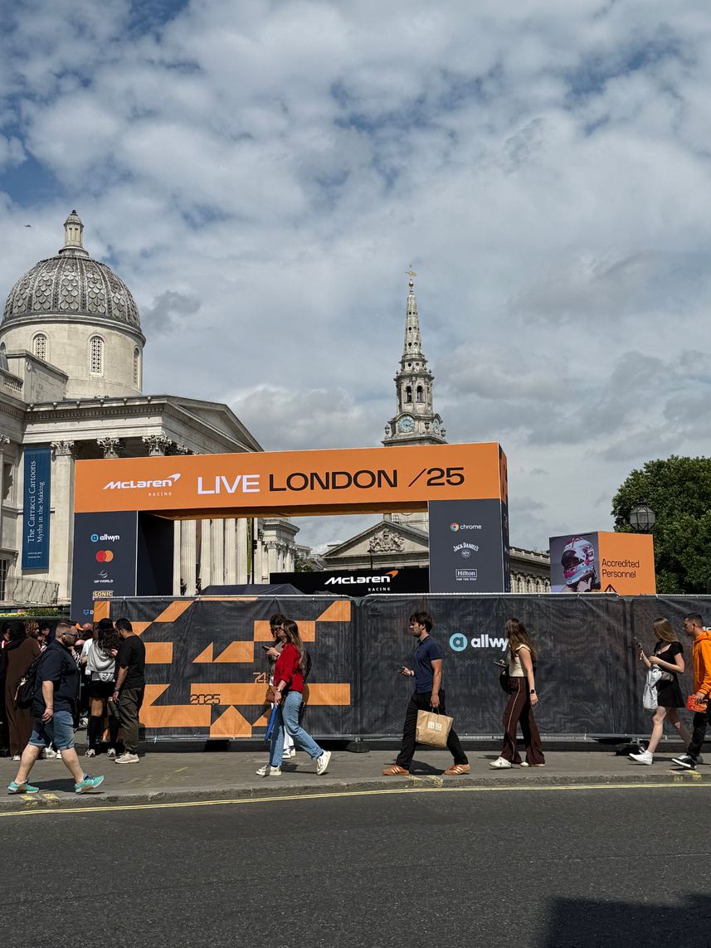

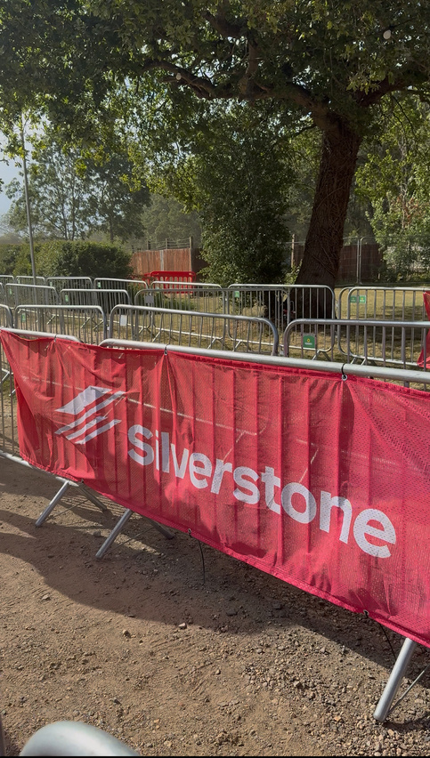
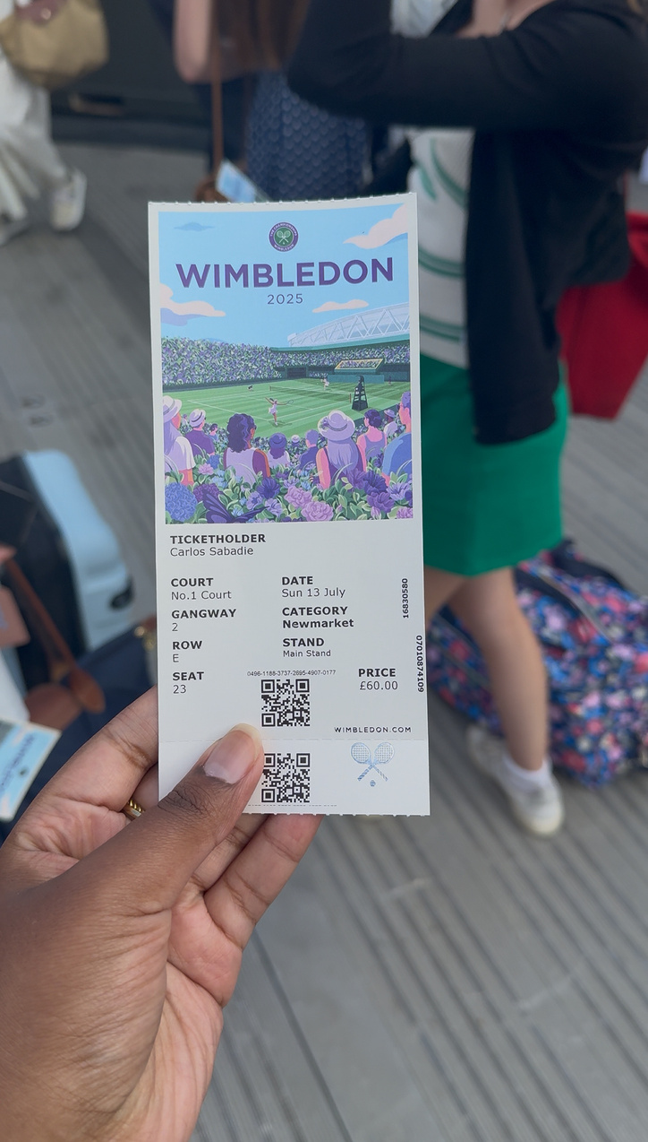
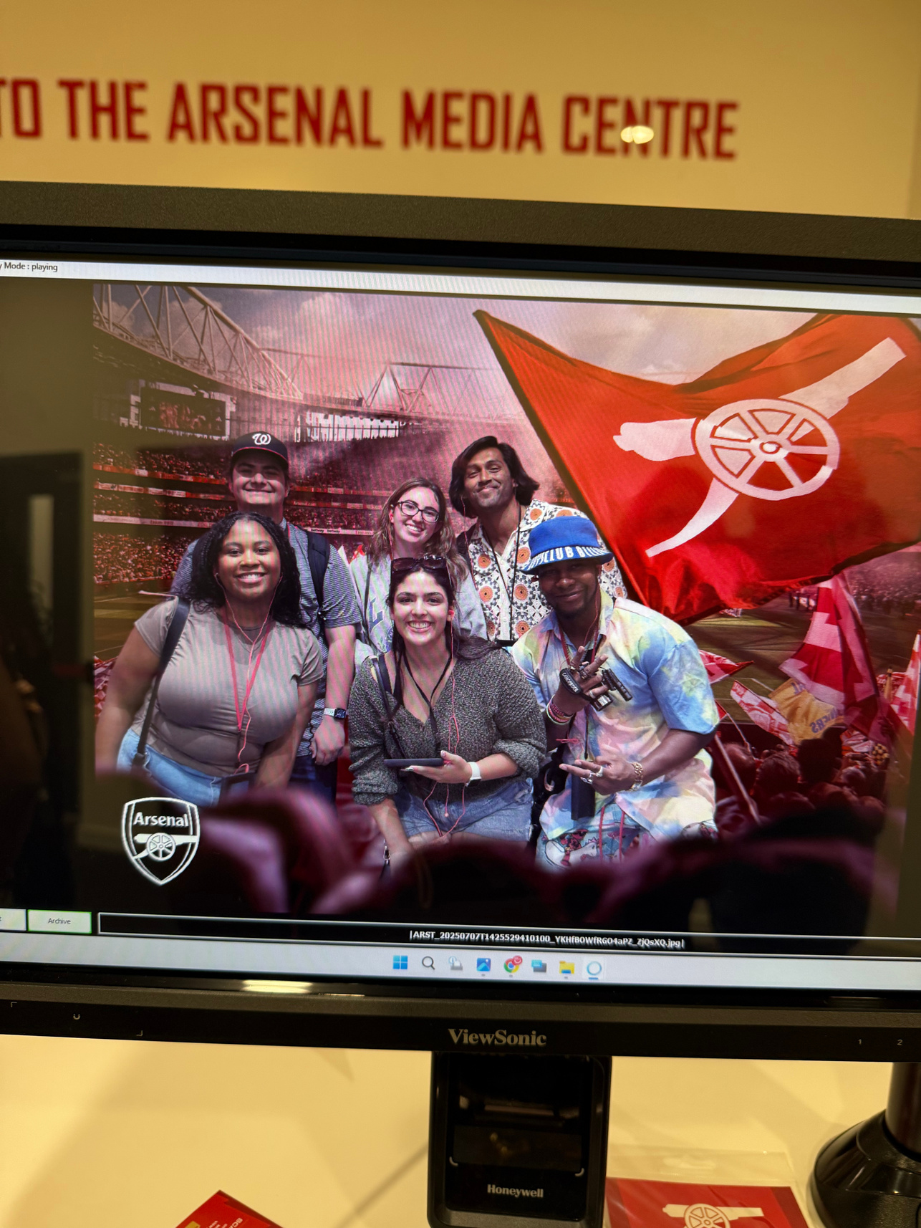

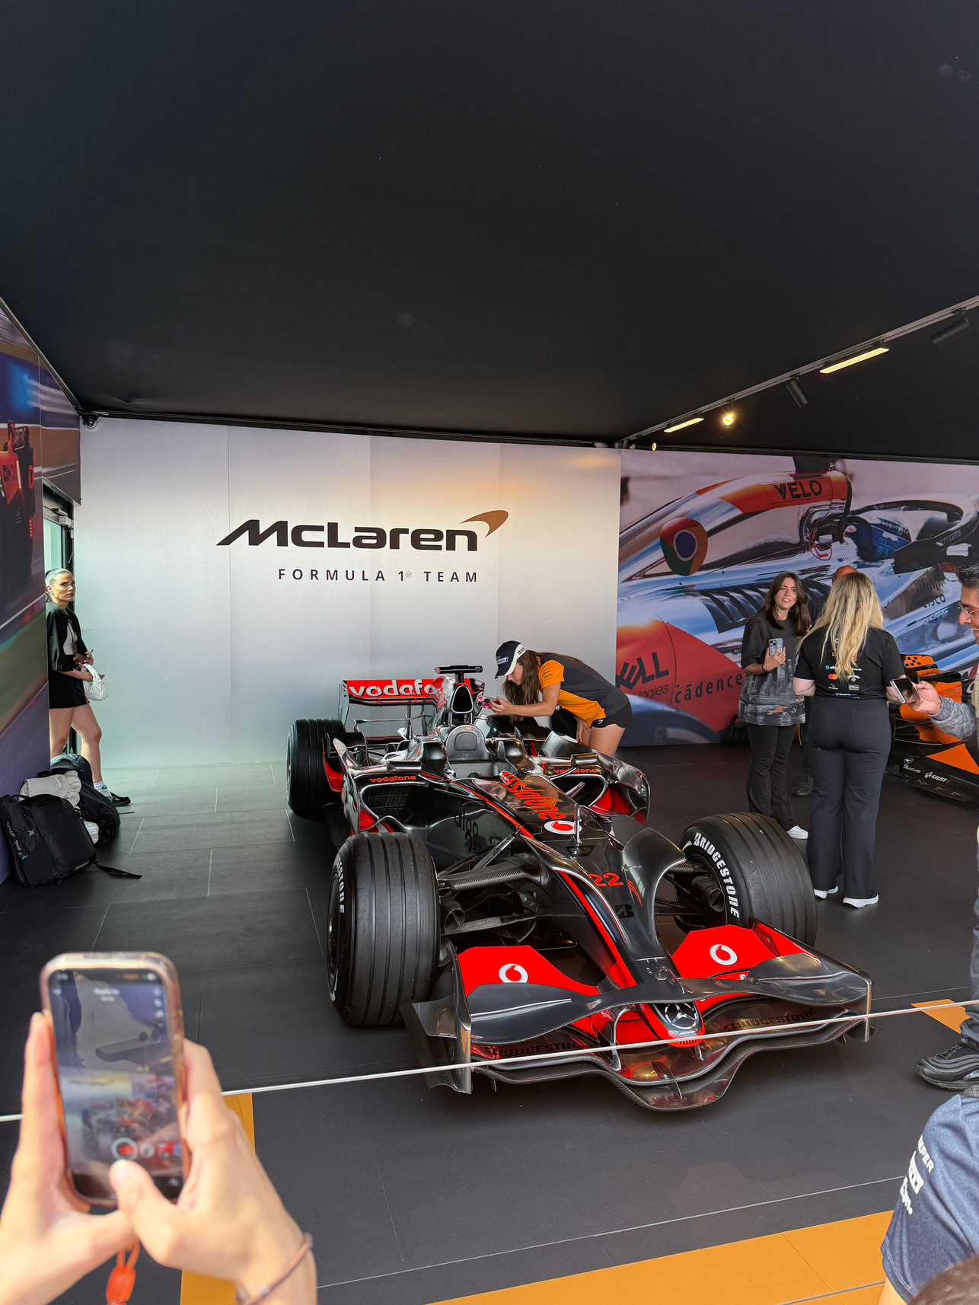
GO TEAM!
Learning about Formula One, Tennis, Golf, and Rugby, has truly made me realize that all of them have one shared aspect within them: community. Learning about the history of some of these sports through the museums, stadium tours, and team meetings made me realize how powerful sports are when it comes to uniting people. To give an example, I learned from the Silverstone museum that Formula One started as a way to cope with the aftermath of WWII which brought the country together to show optimism despite the hardship of the time period. Regardless of age, gender, race or social class, sports fans across the globe come together with a shared passion for sports.

Slide 6

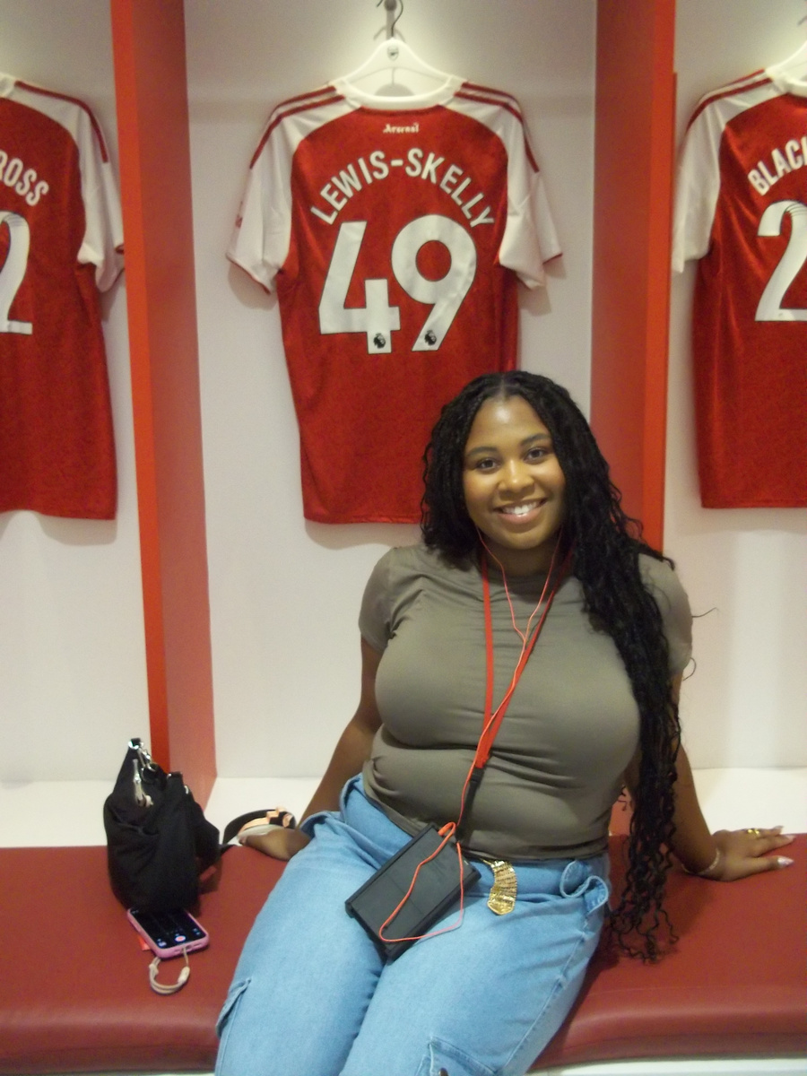
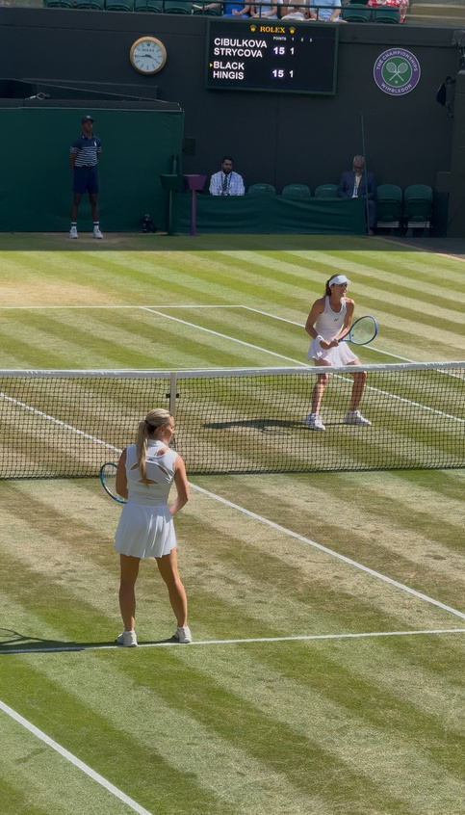



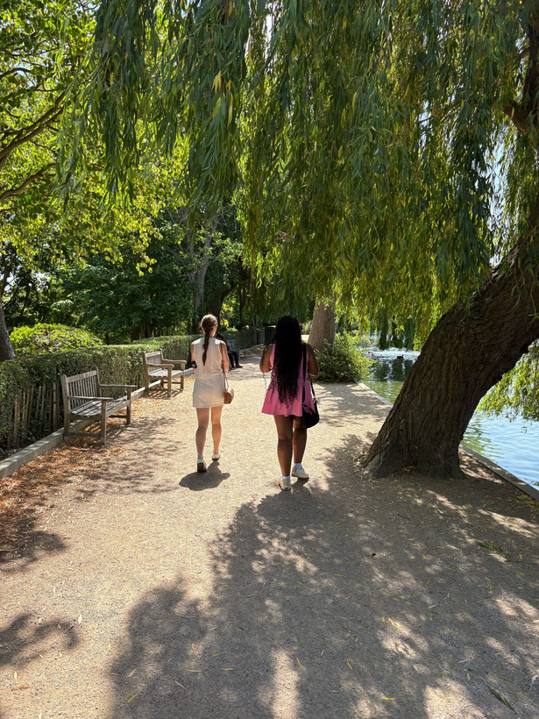
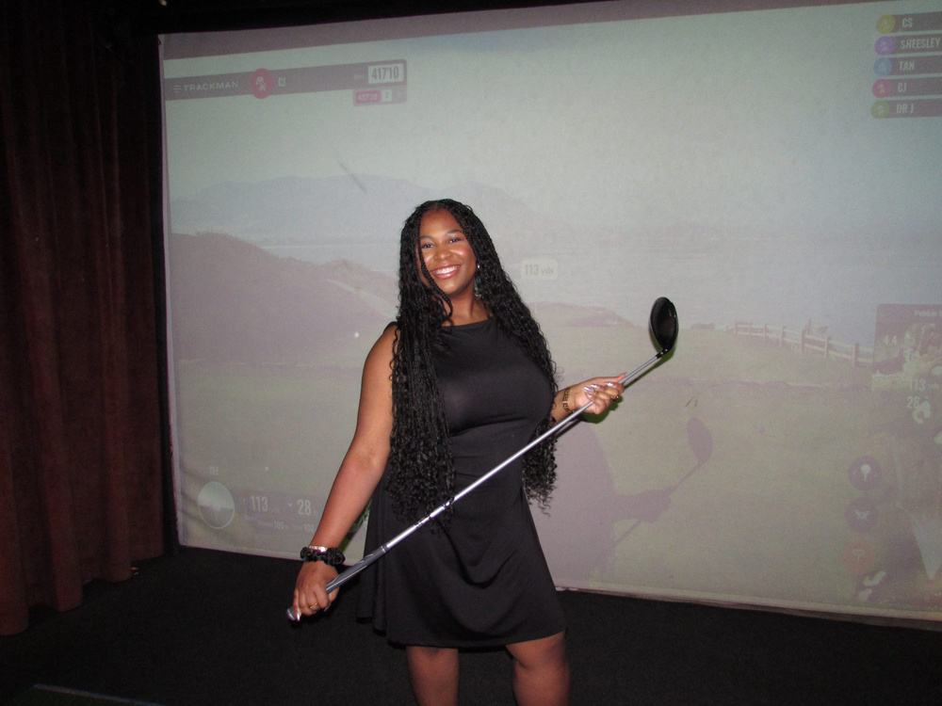

Because I was able to venture out and try something different, it has broadened my perspective on the way I view things that I don’t know much about. One big takeaway from this trip is that sports are all in what you make them. I didn’t hate sports beforehand, I just never understood the true impact behind them and why people gather in big crowds, wait in long lines, and cheer so passionately for their favorite players and teams. Now, after seeing the Wimbledon Championships and the British Grand Prix in person, I completely understand. I may not be the number one tennis or racing fan (yet) but I definitely will continue to keep up with these sports more beyond this trip. I have such a higher respect for them now that I know what exactly goes into these events.
GOLF EXPERT~!!! (NOT REALLY)

Slide 7

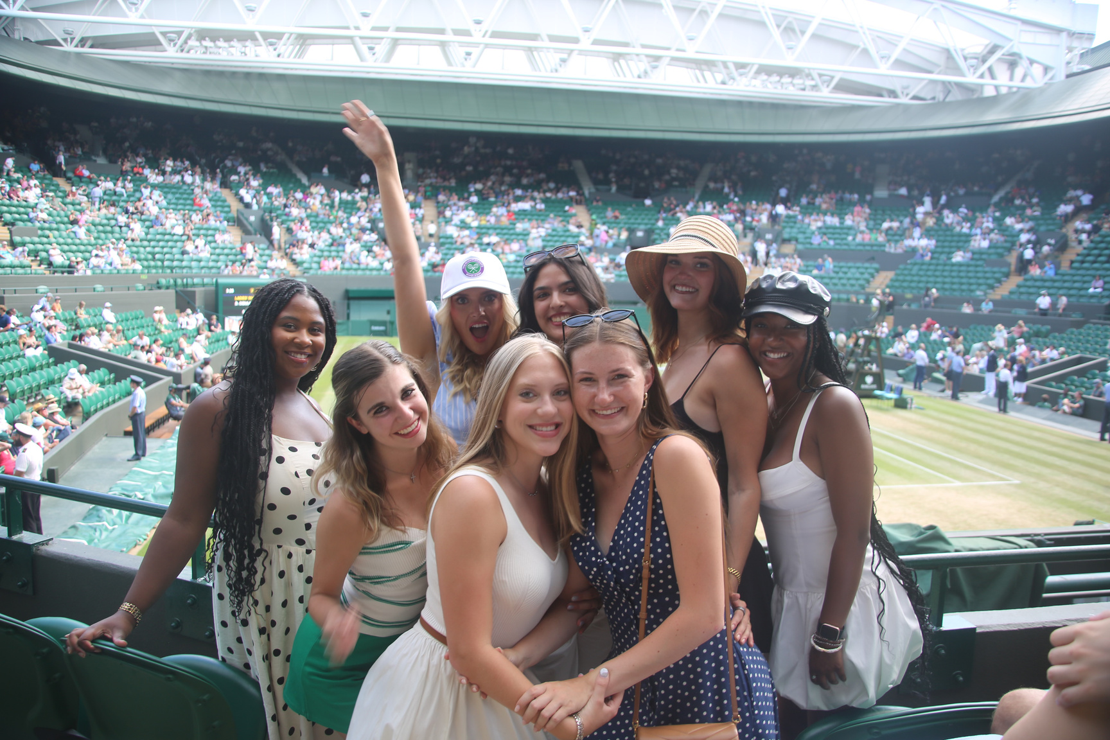

MY NEWFOUND
COMMUNITY
  The Manship Global Sports Showcase allowed me to meet and bond with people over a subject I never thought I would have an interest in. Through this sports-filled journey, I was able to make meaningful friendships with the team which allowed me to broaden my perspective on the industry of sports and build a sense of community, and at the end of the day that is what being a sports fan is all about.
#GEAUXMANSHIP

